Slide 1
3- Ethics and Leaders
Servant Leadership Core Slides
Dr. Kent M. Keith
2022

Slide 2
Ethics and Leaders

Slide 3
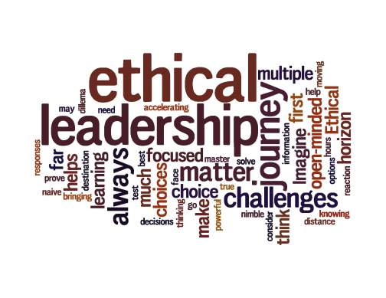

Questions
How would you describe an ethical leader?
What traits or characteristics would you include in your description? Why?

Slide 4
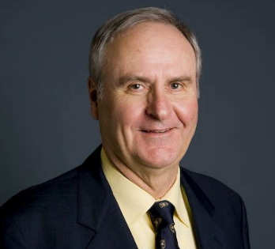

James O’Toole
Creating the Good Life
According to James O’Toole, Aristotle believed that virtuous leaders make their decisions based on reason and not self-interest
Aristotle thought that the true leader derives happiness from serving the common good
“Service to others comes close to being Aristotle’s definition of leadership”

Slide 5
James O’Toole
Creating the Good Life
Virtuous leaders must have a clear view of community needs and goals
“Virtuous leaders create justice, defined as the opportunity for all members of the community to realize their potential”
Leadership should be both practical and moral, both effective and concerned with justice

Slide 6
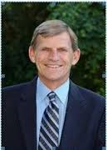
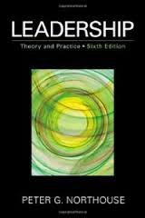
Northouse on the behaviors of ethical leaders
According to Northouse, ethical leaders:
    Respect others
    Serve others
    Show justice
    Manifest honesty
    Build community
  --Peter G. Northouse, Leadership:
  Theory and Practice

Slide 7
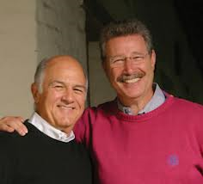
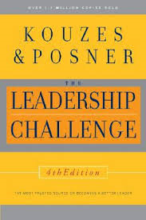
Admired leaders
Leadership experts James Kouzes and Barry Posner asked 75,000 people around the world what they look for and admire in a leader
The top-ranked characteristic over a twenty-year period was “honesty.”
People want to follow someone who is truthful, ethical, and principled.

Slide 8
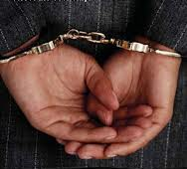
Unethical behavior
Most of us are shocked and disappointed when a leader— public, private, or non-profit— behaves unethically
That’s because the ethical behavior of leaders has a significant impact on the ethical behavior of others in their organizations
Our leaders must set a good example, because the repercussions are significant

Slide 9

The moral foundation
“…the endurance of organization depends upon the quality of leadership; and that quality derives from the breadth of the morality upon which it rests.”
--Chester Barnard,The Functions of the Executive

Slide 10
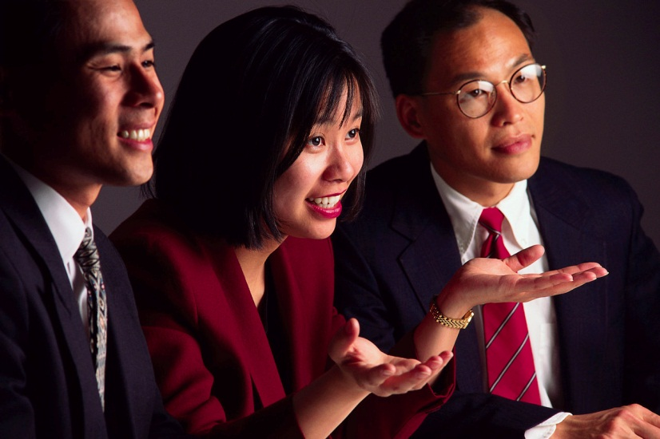
Setting the moral tone
“The CEO today has to be the moral leader of the company.”
--Jeffrey Immelt
Former Chairman and CEO, General Electric

Slide 11

Leaders are examples
People are always watching their leaders
People look to their leaders as examples of how to live and work ethically
People look to their leaders for examples of how to live the organization’s values

Slide 12

The ethical behavior of leaders sends a signal
“The witness of leaders both communicates the ethics of our institutions and establishes the desired standards and expectations leaders want and often demand from their fellow workers and followers.”
--Al Gini in Ethics, the Heart of Leadership

Slide 13

Unethical behavior and organizational decline
In a survey in the United States, 68% of those surveyed believed that the unethical behavior of executives is the primary cause of decline in business standards, productivity, and success.
--Al Gini in Ethics, the Heart of Leadership

Slide 14

Unethical behavior generates more unethical behavior
The survey found that when business leaders had low ethical standards, workers felt justified in responding through absenteeism, petty theft, indifference, and poor performance on the job.

Slide 15
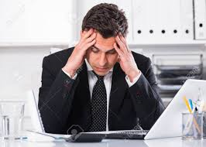
You must act
Many people in an organization usually know about misbehavior and they know when leaders allow it to continue
If you are a leader, and you know that something unethical or immoral is going on within your organization, and you do not act to stop it, you are sending the signal that (1) you don’t care, or (2) the immoral activity is okay with you
To set a moral example, you must take action

Slide 16

Questions
Would you take action if…
  You know that one employee is taking credit for another employee’s work
  You know that an employee is taking supplies from the office
  You know that an employee regularly takes long breaks and long lunch hours away from the office
  You know that an employee has accepted a kickback from a vendor that he selected for your organization

Slide 17

Questions
Would you take action if…
  You know that an employee lied on the resume he submitted when he applied for the job
  You know that an employee is cyberbullying another employee
  You know that an employee is sexually harassing another employee
  You know that an employee is abusing alcohol or drugs outside of office hours

Slide 18

Hypothetical Case Study
The university president discovered that the Athletic Director has been getting staff members to work on his home during work hours— and a lot of people know about it
The AD personally collects the cash receipts from admission to university basketball games; the amount of money has been declining, and recently all the cash went missing; the AD cannot account for it

Slide 19
Hypothetical Case Study
The AD has many friends on the university Board and is well connected in the larger community
He believes that Board members will support him and no staff member will testify against him
One of his close friends is a leading litigation attorney, someone the AD knows will fight for him if there is any attempt to discipline him

Slide 20
Questions
It is clear to the university president that the AD’s behavior has violated the university’s values and code of conduct, and the theft of cash is criminal
Do you think the president should discipline or fire the Athletic Director? Why or why not?
If he decides to discipline or fire the AD, what steps do you think the president should take before, during, and after he takes action against the AD? Why?

Slide 21

Comments or questions…

Slide 22
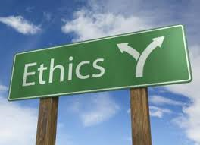
Questions
Name a leader you believe to be ethical, and explain why.
Have you ever followed or worked for a leader who was unethical? How did that make you feel?
Have you ever followed or worked for a leader who is exceptionally ethical? How did that make you feel?

Slide 23
Capt. Crozier,
the USS Theodore Roosevelt,
and the Coronavirus

Slide 24
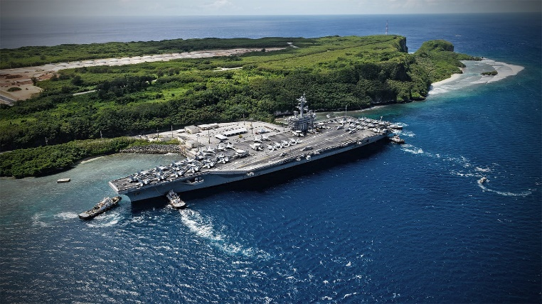
USS Theodore Roosevelt
COVID-19 was detected on board the nuclear aircraft carrier in March 2020 while it was at sea
The ship was ordered to Guam, where initially 800 crew members were removed for quarantine

Slide 25
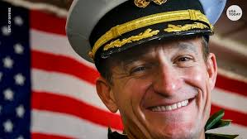
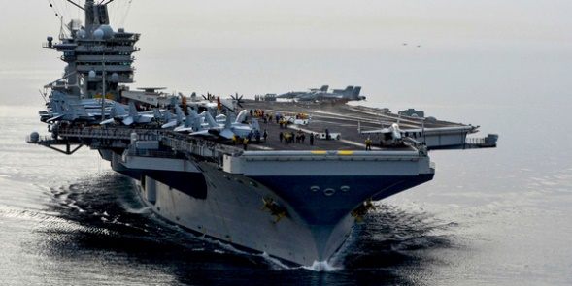
Capt Brett Crozier
USS Theodore Roosevelt
Capt. Crozier wanted nearly all of his crew of 4,845 to be quarantined onshore, but his immediate superior disagreed
After waiting several days and not getting the help he felt his crew needed, Crozier sent an email with an attached 4-page letter

Slide 26
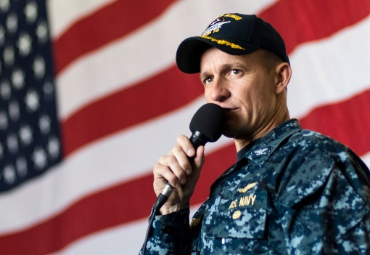
The email with the letter
The email with the letter was addressed to Rear Adm. Stuart Baker, commander of the Roosevelt's carrier strike group; Adm. John Aquilino, commander of U.S. Pacific Fleet; and Vice Adm. DeWolfe Miller, commander of Naval Air Forces. Seven other captains were copied.
In the email, Crozier called the recipients [the admirals] "incredible leaders" whom he would "gladly ... follow into battle whenever needed."

Slide 27
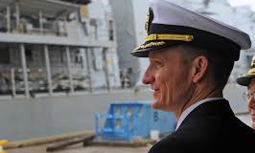
Crozier email
In the email, Crozier said: "I fully realize that I bear responsibility for not demanding more decisive action the moment we pulled in, but at this point my only priority is the continued well-being of the crew and embarked staff," he wrote. "As you know, the accountability of a commanding officer is absolute, and I believe if there is ever a time to ask for help it is now regardless of the impact on my career."

Slide 28
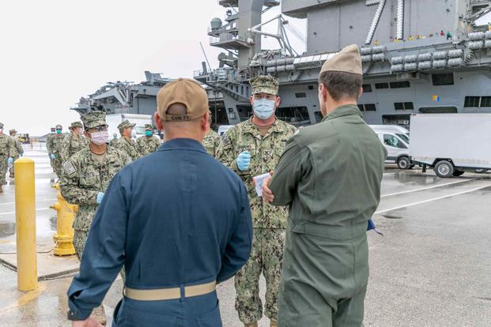
The plea
“Sailors do not need to die," Capt. Cozier said in the attached letter, pleading for 90% of his crew of 4,845 to be removed from the USS Roosevelt so that they could be tested and go into quarantine
"We are not at war, and therefore cannot allow a single Sailor to perish as a result of this pandemic unnecessarily," Crozier wrote

Slide 29
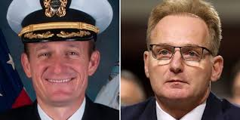
Capt. Crozier dismissed
Somebody leaked Crozier’s letter, which was published by the San Francisco Chronicle on March 31, by which time 100 sailors on the USS Roosevelt had tested positive
Acting Navy Secretary Thomas Modly said Crozier had sent the letter to 20 or 30 people and had “exercised extremely poor judgement” by distributing it
Modly relieved Crozier of his position on April 2

Slide 30

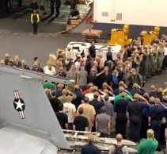
Capt. Crozier’s departure
Hundreds of crew members cheered and saluted Capt. Crozier as he left the ship

Slide 31

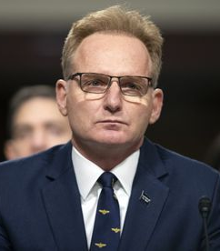
Secretary Modly
Acting Navy Secretary Modly traveled 8,000 miles to visit the USS Roosevelt in Guam, where the aircraft carrier was in port
His trip cost $243,000 and was taken without the required advance permission
Secretary Modly addressed the crew on a variety of issues on April 5; his talk was leaked and became public

Slide 32
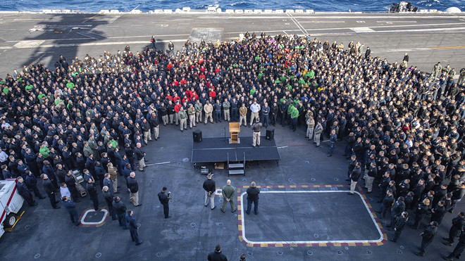
Modly addressed the crew
Modly told the crew that “if he [Crozier] didn't think that information was going to get out into the public, in this information age that we live in, then he was A, too naive or too stupid to be the commanding officer of a ship like this. The alternative is that he did this on purpose. And that's a serious violation of the Uniform Code of Military Justice, which you are all familiar with.”

Slide 33
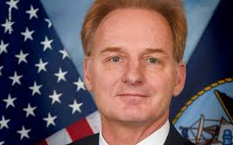
Modly also said
Modly noted that 800 to 1,000 crew members were already on shore, and they had been there since March 25 trying to make arrangements to get the rest of the crew off the ship
He said that the Governor of Guam was put in a tough spot by Crozier’s letter, because the people of Guam didn’t want 5,000 sailors on shore who had might have the coronavirus

Slide 34
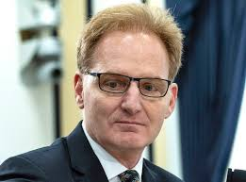
Modly also said
Modly said: “Love the people you are ordered to lead. Make sure they eat before you do. Care about their families as much as your own. Be invested in their success more than your own accomplishments. Nurture their careers… And value their lives… It is only through this level of servant leadership that you will maximize and empower those you lead to meet the demands that will face us in this century.”

Slide 35
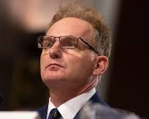
Modly also said
“It is the mission of the ship that matters… Your captain lost sight of this and he compromised critical information about your status intentionally to draw attention to your situation… I judged that it could not be tolerated from the commanding officer of a nuclear aircraft carrier. This put you at great risk even though I am certain he never thought it would.”

Slide 36
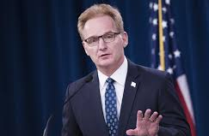
Modly also said
He said that the media has an agenda and will use information to embarrass the Navy
He said that the captain’s actions had implications for other Navy ships: “Imagine if every other CO also believed that the media was the proper channel to hear grievances with their chain of command under difficult circumstances… We would no longer have a Navy. And not longer after that, we’d no longer have a country.”

Slide 37
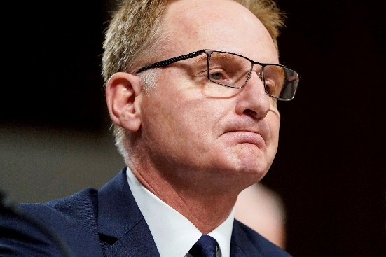
National outcry
The Washington Post reported: “In profanity-laced remarks over a loudspeaker, Modly assailed Crozier’s character, accusing him of either leaking a letter about his concerns to the news media or of being ‘too naive or too stupid to be the commanding officer of a ship like this.’”
The national outcry over Modly’s remarks about Crozier led to Modly’s resignation on April 7

Slide 38

National hotspot
As the 4,845 crew members were tested, it was discovered that more than 600 were infected, including Capt.Crozier
When the number of infected crew members reached 585, the USS Roosevelt became the biggest coronavirus “hotspot” in the entire United States

Slide 39
Testing
On April 13, a USS Roosevelt crew member died of coronavirus
When testing for coronavirus was completed, it was found that more than 1,156 crew members had tested positive

Slide 40

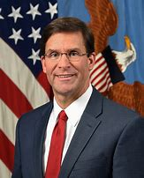
Navy recommendation to reinstate
A Navy investigation resulted in a recommendation that Crozier be re-instated as Captain of the USS Roosevelt
While Navy regulations didn’t require the Defense Secretary to approve, on April 24, Defense Secretary Mark Esper said he couldn’t sign off on the Navy’s recommendation

Slide 41
Resurgent cases
The USS Roosevelt set sail again in late May with 3,000 crew members (1,800 still in quarantine)
Preventive measures were being implemented
After setting sail, 14 sailors tested positive for the virus, weeks after they had twice tested negative
There were other “resurgent” positive cases

Slide 42
Questions
What were the ethical issues in this case?
What were the professional/military issues?
If you were Capt. Crozier at the time, what would you have done? Why?
If you were Secretary Modly at the time, what would you have done? Why?
Does the subsequent result of the Covid-19 tests and the death of a sailor change your view?

Slide 43
Comments or questions…

Slide 44
Creating an Ethical
Environment

Slide 45
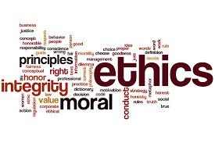
Creating an ethical environment
One of the challenges for an ethical leader is to create an environment within his or her organization that is fair, so that people will not feel “justified” in cheating or stealing in order to get back at the organization
People must believe that they can survive and thrive by being ethical; they won’t fall behind those who are being unethical

Slide 46
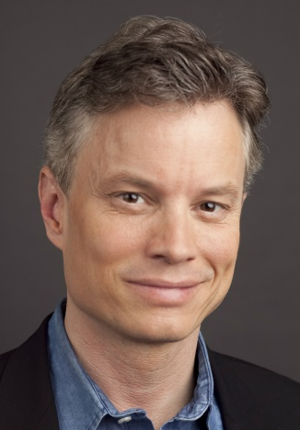
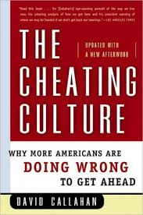
David Callahan
The Cheating Culture
People tend to cheat when they think the rules or the organizational environment are unfair
For example, wealthy people don’t pay taxes due to loopholes, so less wealthy people feel they don’t have to file honest tax returns
In 2004, it was estimated that people owed the IRS $500 billion more per year than they were paying

Slide 47
David Callahan
The Cheating Culture
“White collar crime” occurs on a massive scale
The Association of Certified Fraud Examiners estimated that in 2002 the annual total losses from workplace fraud was $600 billion, or 6 percent of the country’s Gross Domestic Product
One fraud examiner said that workplace fraud is “easily the most costly form of economic crime in the world”

Slide 48
David Callahan
The Cheating Culture
People will steal from their company if they feel they are underpaid
The cost of employee theft was estimated by Ernst & Young to be $600 billion in 2002 ($4,500 for each U.S. employee)
It is estimated that one in every 22 retail employees stole from his or her employer in the year 2000

Slide 49
David Callahan
The Cheating Culture
Cable piracy is “justified” by people who say that the cable companies have a local monopoly, they overcharge, they don’t provide good service, and they are rude to customers
The industry estimates that annual losses from cable TV theft are more than $6 billion (2004)
The losses result in higher charges for honest customers

Slide 50
David Callahan
The Cheating Culture
“If vast income gaps are left unaddressed… if so many Americans continue to feel economically insecure… and if a two-tier system of justice continues to prevail— one for the rich and one for everyone else— more and more people will question the basic legitimacy of the social contract governing our society… Many of us will make up our own ethics and rules.”

Slide 51

Question
Some argue that people behave in an immoral fashion when society is unjust— when people are stuck in poverty, are victims of discrimination, are disenfranchised politically, etc.
Since life is not fair, they strike back with immoral actions, believing they have little to lose.
A bumper sticker says: If you want peace, establish justice.
What do you think?

Slide 52
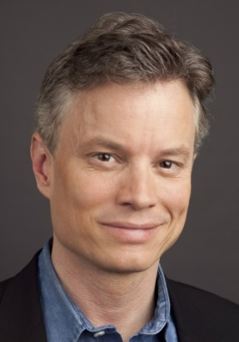
David Callahan
The Cheating Culture
“We need to create a new social contract in America that gives people faith in a few simple principles: Anyone who plays by the rules can get ahead. Everyone has some say in how the rules get made. Everyone who breaks the rules suffers the same penalties. And all of us are in the same boat, living in the same ‘moral community’ and striving together to build a society that confers respect on people based on a wide variety of accomplishments.”

Slide 53
Comments or questions…

Slide 54
Morality and Morale

Slide 55
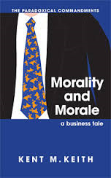
Morality and Morale
The book Morality and Morale: A Business Tale, is available to download at no charge as a PDF. It can be found at these two websites:
www.carlsonkeith.com, Book Room, Dr. Keith’s Library
www.kentmkeith.com, The Universal Moral Code

Slide 56
Questions
Morality and Morale
What is the moral dilemma faced by John?
What did he learn from:
  Uncle Rick? (Chapter Two)
  Lindsay Chang? (Chapter Three)
  Art and Ethel Duggins? (Chapter Four)
  Bob Hernandez? (Chapter Five)
  Aunt Marie? (Chapter Six)

Slide 57
Questions
Morality and Morale
In addition to the advice John has received from others, what else should he consider? What principles or virtues are relevant?
What would you decide to do, if you were John? Why?

Slide 58

Surveys: Sources of Meaning at Work
Dr. Keith conducted surveys of hundreds of individuals in the US— teachers, business people, college students, community leaders, Army officers, social workers, nurses
Participants were asked to rate 34 different potential sources of meaning at work according to which sources were most meaningful to them

Slide 59

Survey Results: Meaning at Work
  The highest-rated sources of meaning were:
  Always doing my personal best
  Supporting my family
  Making a difference
  Setting a good example
  Living my values
  A sense of accomplishment
  Always doing what’s right
  Solving problems

Slide 60

Meaning at work
  The world can change, inside and outside your organization
  Issues can be unclear, foggy, confusing
  Whatever happens, you can still find daily meaning by living your core values and doing what’s right

Slide 61

Your purpose matters
“A sense of meaningfulness is the opportunity you feel to pursue a worthy task purpose… that you are on a valuable mission, that your purpose matters in the larger scheme of things.”
  --Dr. Kenneth W. Thomas, Intrinsic Motivation at Work: Building Energy and Commitment

Slide 62
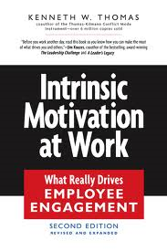
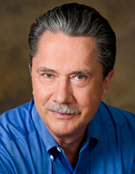
Intrinsic motivation at work
Dr. Kenneth W. Thomas and his colleagues studied intrinsic motivation at work
They concluded that meaning is an important intrinsic motivator
There are many benefits to intrinsic motivation

Slide 63
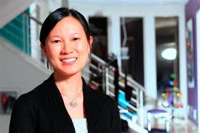
Benefits of intrinsic motivation at work
  “Studies show that the intrinsic rewards are consistently related to job satisfaction and to performance. These findings hold across types of organizations and for managers as well as workers.”
    --Dr. Kenneth W. Thomas, Intrinsic Motivation at Work: Building Energy and Commitment

Slide 64

Benefits of intrinsic motivation at work
“Studies have also shown that the intrinsic rewards are related to innovativeness, commitment to the organization, and reduced stress.”
    --Dr. Kenneth W. Thomas, Intrinsic Motivation at Work: Building Energy and Commitment

Slide 65
Moral energy
Living your values and doing what’s right can give your work meaning, and that meaning can be an intrinsic motivator that supports your performance at high levels
Living your values and doing what’s right can give you a kind of moral energy

Slide 66
Comments or questions…

Slide 67
Ethical Breakdowns
and Successes

Slide 68
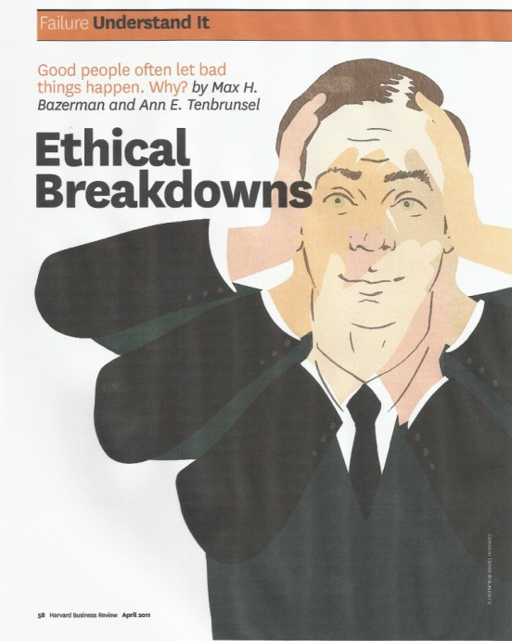
Ethical Breakdowns
Max H. Bazerman and Ann E. Tenbrunsel
Harvard Business Review – April 2011
Corporate corruption is widespread
Employees bend or break ethics rules because those in charge are blind to unethical behavior and may even unknowingly encourage it

Slide 69

Five Barriers to an Ethical Organization
Ill-conceived goals
Motivated blindness
Indirect blindness
The slippery slope
Overvaluing outcomes

Slide 70

Ill-Conceived Goals
  Sears, Roebuck gave automotive mechanics a sales goal of $147 per hour
  Instead of working faster, employees met the goal by overcharging for their services and “repairing” things that weren’t broken

Slide 71

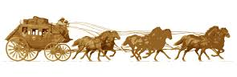
Ill-Conceived goals
In response to aggressive company goals, Wells Fargo employees created 3.5 million accounts without the knowledge or permission of customers
The bank has spent more than $600 million settling lawsuits arising from the fraud
The company has tried to re-establish the trust of its customers

Slide 72

Ill-Conceived Goals
Another example:
  A university recruiter set high enrollment goals each semester
  To reach the goals, he promised students financial aid
  When the students arrived, he said there was no money for them

Slide 73
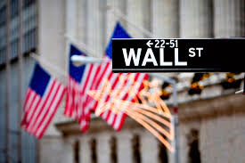
Hurting millions
  In 2008, the economy collapsed due to the greed and dishonesty of a few dozen individuals and firms on Wall Street with high profit goals
  Wall Street leaders thought that it was okay to sell subprime mortgages because it was a clever thing to do— even though they knew the mortgages would fail and people would get hurt
  The economic crash hurt millions of people, destroying dreams, jobs, and retirement accounts

Slide 74
Motivated Blindness
Standard & Poor’s gave AAA ratings to collateralized mortgage securities of demonstrably low quality, which led to the market crash
S&P was paid by the companies whose securities they rated
S&P knew that the rating firm with the lowest standards would be hired by the securities companies

Slide 75
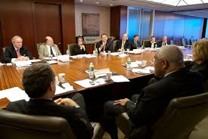
Motivated Blindness
Another example:
  A board member of a non-profit harassed the staff and engaged in conflicting activities
  Other board members ignored his behavior because he was a major donor

Slide 76
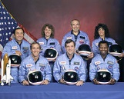
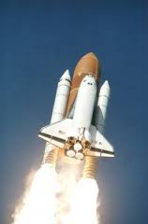
Motivated blindness
The Space Shuttle Challenger disaster occurred in 1986 when it broke apart 73 seconds into its flight, leading to the deaths of its seven crew members.
Disintegration was due to the failure of an O-ring seal at low temperatures
NASA managers knew about the potential flaw; they were warned by engineers, but they wanted to launch, so they ignored the warning

Slide 77
Indirect Blindness
Merck sold two cancer drugs to a smaller company
The smaller company raised the wholesale price of the drugs by 1000%
Merck didn’t want to raise the price— it wanted some other company to do it, so Merck wouldn’t be responsible (no negative impact on its reputation)

Slide 78

Indirect Blindness
Another example:
  A consultant wrote a book that violated the copyright of another author
  The consultant claimed it was not his fault because he had hired a ghost writer, who did the plagiarizing (“outsourced the dirty work”)

Slide 79
The Slippery Slope
If we accept minor infractions, we are likely to accept increasingly major infractions, as long as each violation is only incrementally more serious than the preceding one

Slide 80
The Slippery Slope
An example:
  Enron was an energy company
  It used accounting loopholes, special purpose entities, and poor financial reporting to hide billions of dollars in debt from failed deals and projects
  Enron inflated its income figures by $586 million over four years

Slide 81

Slippery Slope
Enron pressured the auditor, Arthur Anderson to ignore the irregularities
Enron filed for bankruptcy in late 2001
Executives sold $1 billion in company stock while telling employees not to sell
The employee retirement fund was nearly wiped out and investors lost $60 billion
Arthur Anderson closed down

Slide 82
Overvaluing Outcomes
Scenario: one pharmaceutical researcher used data with technical problems, and people died; another researcher made up data, and nobody died
People judge the first researcher more harshly, even though he was ethical in using real data, because of the bad outcome in his case

Slide 83
Overvaluing Outcomes
Another example:
  Corporations under pressure from institutional investors may lay off employees for a temporary “uptick” in the stock price so the investors can sell at a higher price
  Employees, their families, their communities, and remaining workers suffer

Slide 84
Comments or questions…

Slide 85

A positive example
  Johnson & Johnson said its first responsibility is to doctors, nurses, patients, mothers, and fathers and all others who use their products
  Next, they are responsible to employees
  Then, they are responsible to the communities in which they live and work and the world community as well
  Finally, the are responsible to stockholders

Slide 86
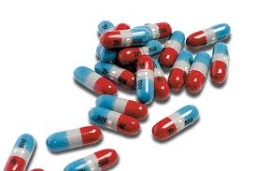
Tylenol
In 1982, Tylenol was the most successful over-the-counter product in the United States with over 100 million users
Tylenol was the absolute leader in the painkiller field accounting for a 37 percent market share, outselling the next four leading painkillers combined, including Anacin, Bayer, Bufferin, and Excedrin

Slide 87
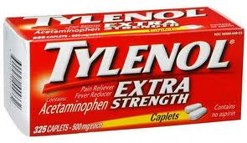
The Tylenol Crisis
In 1982, seven people died after taking Tylenol capsules that had been poisoned with potassium cyanide
Johnson & Johnson distributed warnings to hospitals and distributors and halted Tylenol production and advertising

Slide 88
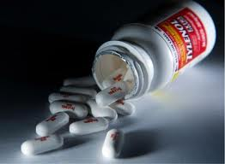
Tylenol Crisis
Johnson & Johnson immediately issued a nationwide recall of Tylenol products; an estimated 31 million bottles were in circulation
When it was determined that only capsules were tampered with, Johnson & Johnson offered to exchange all Tylenol capsules already purchased by the public with solid tablets

Slide 89
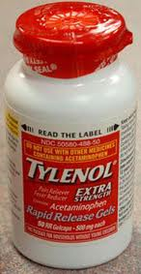
Tylenol Crisis
Johnson & Johnson created new triple safety seal packaging— a glued box, a plastic seal over the neck of the bottle, and a foil seal over the mouth of the bottle.
Tylenol became the first product in the industry to use the new tamper resistant packaging just 6 months after the crisis occurred

Slide 90
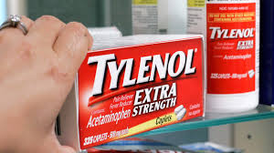
Tylenol
The crisis cost the company as much as $500 million
The company’s leadership set an ethical example from the beginning by making public safety their number one concern
The media gave the company positive coverage; public trust was enhanced

Slide 91
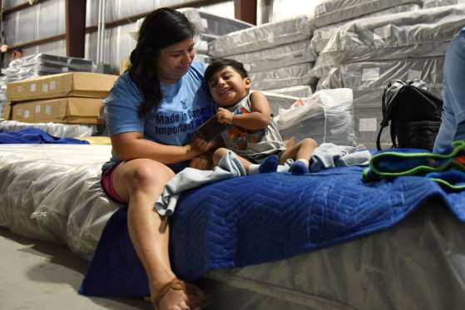
Hurricane Harvey and Mattress Mack
In 2017 when Jim McIngvale woke up in his home filled with two to three feet of water, he headed to work and decided to open a couple of his Mattress Mack furniture stores in Houston as shelters
He sent out 10-15 company trucks to rescue people trapped in their homes, rescuing 200
400 people stayed at his stores, which have bathrooms, showers, and restaurants

Slide 92

The world’s most ethical companies
Forbes magazine reported on the world’s most ethical companies for 2017– a total of 124
The list is a result of a survey by Ethisphere, with five criteria, including the company’s ethics and compliance program; whether ethics are embedded in the culture from top to bottom; separation of the Board Chair and CEO roles; corporate citizenship and responsibility; and leadership, innovation, and reputation

Slide 93
The world’s most ethical companies
Thirteen companies have made the cut every single year for eleven years: Aflac, Deere & Company, Ecolab, Fluor, GE, International Paper, Kao Corporation, Milliken and Company, PepsiCo, Starbucks, Texas Instruments, UPS and Xerox
Other companies on the list are Dell, Ford, Kellogg, Levi Strauss, Microsoft, T-Mobile, Volvo, and USAA

Slide 94
Comments or questions…

Slide 95
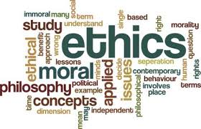
Questions
What organizations do you know to be highly ethical?
What makes them highly ethical?

Slide 96
Learning to Be Ethical

Slide 97

Prerequisites for leadership
The impact of the ethical behavior of leaders is so important that an understanding of ethical issues and a track record of ethical decision-making should be prerequisites for promotion to leadership positions

Slide 98
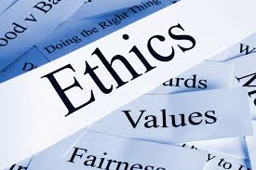
Where do leaders learn ethics?
Leaders can learn from their families, their religious institutions, and their schools
However, many ideas or theories of leadership do not include ethics.
Many leadership theories are about skills or techniques designed to get other people to do things
These skills or techniques can be used for good or ill

Slide 99
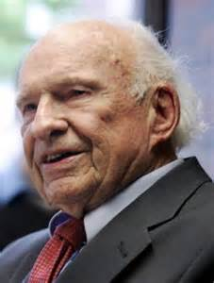
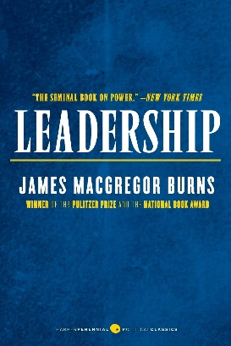
From Burns to Bass:
Abandoning the moral element
In his book, Leadership, James MacGregor Burns described political leadership as a moral process of “leading people upward, to some higher values or purpose or form of self-fulfillment.” He called it transforming leadership, because it transformed both the leader and the led. He said that it is “moral but not moralistic. Leaders engage with followers, but from a higher level of morality…”

Slide 100


From Burns to Bass:
Abandoning the moral element
Years after Burns published his book, Bernard Bass sought to enhance the work of Burns by developing the “transformational” leadership theory
Bass said that transformational leaders “could wear the black hats of villains or the white hats of heroes depending on their values”
The techniques of transformational leadership are available to anyone, whether they are ethical or not… The moral purpose of leadership was abandoned in the new definition

Slide 101

Business school professors
There are professors in American business schools who teach that ethics will only slow down or disadvantage a business
Students are taught to stay within the law, but not worry about ethics
They are taught to make cost-benefit analyses, which include the cost of being sued for hurting people (“ethical fading”)

Slide 102

Decisions have impacts
Very few decisions are “ethically neutral” or “value free”
Ethical leaders know that almost every decision they make has an impact on someone
Ethical leaders do their best to identify each potential impact, and then weigh those impacts when making decisions

Slide 103

Every decision
Every business decision affects other people (employees, customers, creditors, shareholders, vendors, communities) so every decision has moral or ethical content
As the Forbes list of the most ethical companies indicates, many ethical companies are very successful
There are bottom-line benefits to being ethical

Slide 104

More profitable
“Ethical companies are more profitable for numerous reasons—
  employees are more productive
  employees are less likely to leave a company
  consumers respond positively to companies that are perceived as ethical
  vendors and suppliers prefer to deal with ethical companies
  ethical companies attract higher talented executives and employees.” --Michael Volkov

Slide 105

Ethical issues can take time
Some ethical issues cannot be resolved by a single, dramatic decision or confrontation
Often, addressing an ethical dilemma will take time; you may need to make a series of smaller decisions, and watch and learn as you go, because consequences are difficult to predict
A decision can change the environment in unexpected ways, requiring decisions on new ethical issues that are now in a new context

Slide 106


Joseph L. Badaracco
Leading Quietly
Badaracco argues that being ethical can be challenging in organizational environments
Often, it is not about being a “hero” but about balancing ethical considerations and patiently seeking the right time to act
The answer is rarely a full frontal assault on people or issues; the leader may need to ask questions, build alliances, and share information

Slide 107
Joseph L. Badaracco
Leading Quietly
“An Unorthodox Guide to Doing the Right Thing”
  Trust mixed motives
  Buy a little time
  Invest wisely
  Drill down
  Bend the rules
  Nudge, test, and escalate gradually
  Craft a compromise

Slide 108
Joseph L. Badaracco
Leading Quietly
One example: buy a little time
“Time lets turbulent waters settle and clarify”
“Time lets people discuss their situations with others and think things through on their own”
“Time gives people a chance to assess their real obligations and gives sound instincts a chance to emerge”

Slide 109
Joseph L. Badaracco
Leading Quietly
Stalling tactics so you have more time to decide:
  Get the staff involved, lots of consultation
  Ask lots of questions that take time to answer
  Generate possible scenarios
  Prepare contingency plans
  Choose slower means of communicating
  Describe the process to the boss
  Focus on other issues that seem more pressing

Slide 110
Joseph L. Badaracco
Leading Quietly
“Three quiet virtues:”
  Restraint— not taking a forceful stand on principle, because that can be the easy way out of a problem, or it can make matters worse
  Modesty— being realistic, not inflating the importance of your efforts
  Tenacity— picking the battles you care about strongly and are likely to see through to the end

Slide 111
Comments or questions…

